Slide 1

DEPARTMENT OF COMPUTER SCIENCE AND ENGINEERING
PROJECT NAME : ENVIRONMENTAL MONITORING.
TEAM NAME : Proj_224786_Team_3
TEAM MEMBERS :
HARIKEERTHI.S(113321104025)
HARITHA.D(113321104027)
HEMALATHA.S(113321104028)
JANANI.M.A(113321104030)

Slide 2
Project Definition:
The Environmental Monitoring using IoT project aims to deploy a network of Internet of Things (IoT) devices to collect real-time data about various environmental parameters.
These parameters typically include temperature, humidity, air quality, pollution levels, soil moisture, and more, depending on the specific objectives of the project.
The collected data is then transmitted to a central database or cloud platform for analysis and visualization, enabling stakeholders to make informed decisions regarding environmental conservation, resource management, and public health.

Slide 3
Objectives:
1.Data Storage and Management:
Implement a database or cloud-based storage solution to securely store the incoming environmental data. Ensure data integrity, availability, and scalability.
2.Data Analysis and Visualization:
Develop analytical algorithms and visualization tools to process and present the collected data in a user-friendly format.
3.Alerting and Notifications:
Set up alerting mechanisms to notify relevant stakeholders when certain environmental thresholds or anomalies are detected.
4.Energy Efficiency:
Design the IoT devices and network to be energy-efficient to ensure long-term operation without frequent battery replacements or downtime.
5.Data Privacy and Security:
Implement robust security measures to protect the collected data from unauthorized access and ensure compliance with data privacy regulations.

Slide 4
6.Community Engagement: Involve local communities, government agencies, and environmental organizations to create awareness. 7.Environmental Impact Assessment: Use the collected data to assess the impact of human activities on the environment. 8.Research and Policy Support: Collaborate with researchers and policymakers to provide valuable data for scientific research and evidence-based decision-making in environmental policies. 9.Cost-Benefit Analysis: Evaluate the project's cost-effectiveness and potential economic benefits, such as improved public health or reduced resource wastage. 10. Long-term Sustainability: Develop a sustainability plan to ensure the continued operation and maintenance of the monitoring network beyond the project's initial phase. By achieving these objectives, the Environmental Monitoring using IoT project contributes to better environmental stewardship, data-driven decision-making, and the overall well-being of communities and ecosystems

Slide 5
IoT Sensor Design
Temperature Sensors: climate control and preventing mold growth.
Air Quality Sensors: Detect pollutants like particulate matter (PM2.5 and PM10), carbon dioxide (CO2), volatile organic compounds (VOCs), and more, to assess indoor and outdoor air quality.
Gas Sensors: Detect specific gases like carbon monoxide (CO), methane (CH4), ozone (O3), and nitrogen dioxide (NO2) to assess air quality and safety.
Light Sensors: Measure light intensity or luminance, important for optimizing natural lighting and energy efficiency in buildings.
Noise Sensors: Monitor noise levels to assess noise pollution and its impact on the environment and human health.
Water Quality Sensors: Assess parameters such as pH, turbidity, dissolved oxygen, and conductivity in water bodies to monitor water quality.
Water Level Sensors: Monitor water levels in rivers, lakes, reservoirs, and tanks to manage water resources and flood control.
Humidity Sensors: Monitor the moisture content in the air, crucial for

Slide 6
Rainfall Sensors: Detect precipitation levels for weather forecasting and flood monitoring.
UV Sensors: Measure ultraviolet (UV) radiation to assess its impact on human health and the environment.
Radiation Sensors: Detect ionizing radiation in nuclear facilities and areas near nuclear accidents.
Camera Sensors: Use image sensors and cameras for visual inspection and surveillance in environmental monitoring.
GPS and Location Sensors: Provide location data for tracking the geographical distribution of environmental parameters.
Water Flow Sensors: Measure the flow rate of water in pipes and channels for water resource management.
Biological Sensors: Utilize biological sensors like biosensors to detect specific biological markers or organisms in the environment, such as bacteria or pollutants
Seismic Sensors: Detect ground vibrations and seismic activity for earthquake monitoring.

Slide 7
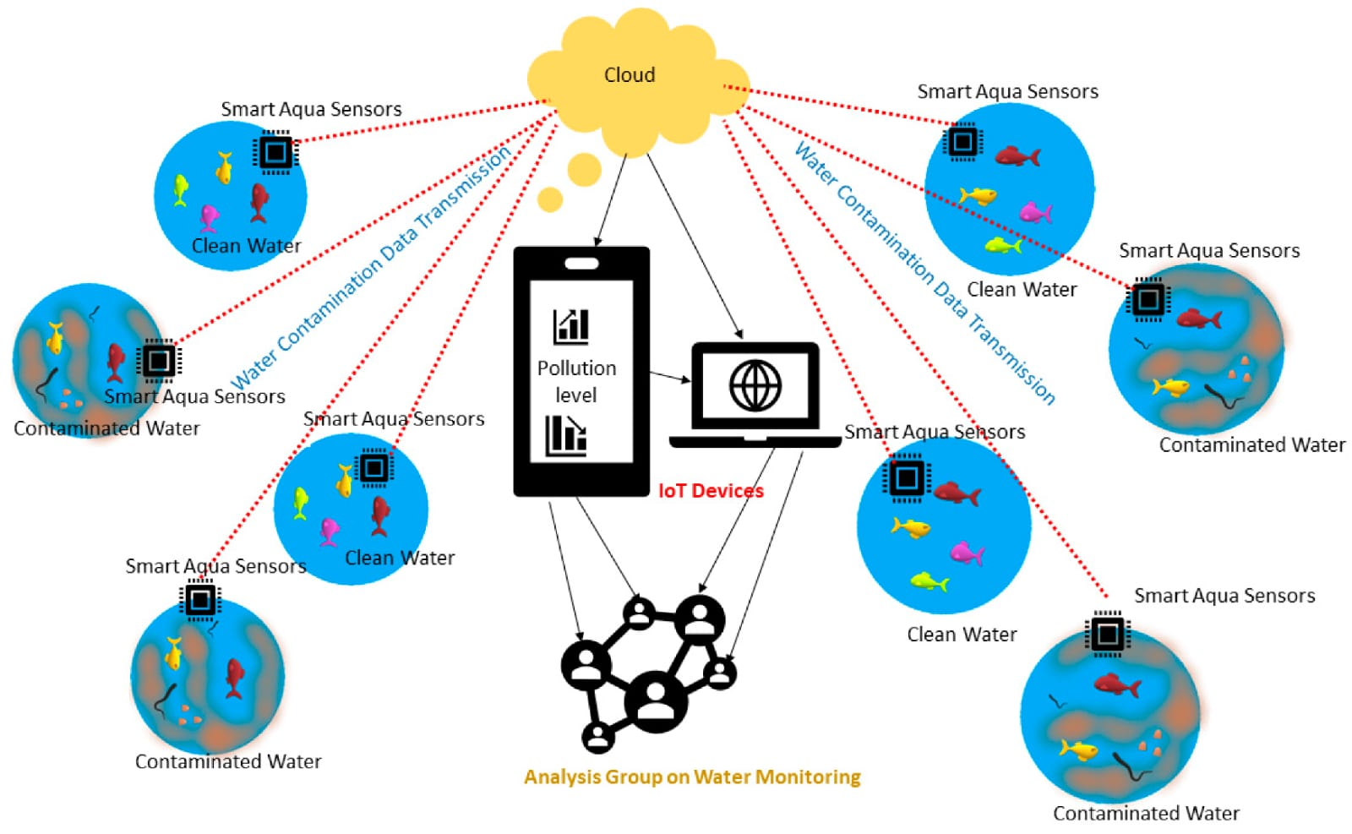

Slide 8
Real-Time Transit Information Platform:
Data Collection:
Set up IoT devices (sensors) to collect environmental data such as air quality, temperature, humidity, and pollution levels. These devices should be capable of transmitting data in real-time.
Data Transmission:
Ensure that the data from these IoT devices is transmitted securely and efficiently to a central server or cloud platform. MQTT or HTTP protocols are commonly used for this purpose.
Data Processing:
On the server/cloud, process the incoming data to clean, aggregate, and format it for analysis.
Translation Module:
Implement a translation module that can convert the collected environmental data into different languages in real-time. You can use machine translation APIs like Google Translate, Microsoft Translator, or custom-trained models for this purpose.
User Interface:
Create a user-friendly interface, which could be a web or mobile app, where users can access the translated environmental data. Ensure that it provides real-time updates and can display data in multiple languages.

Slide 9
Alerts and Notifications:
Implement a system for generating alerts and notifications when environmental parameters exceed predefined thresholds. These alerts should also be available in multiple languages.
Data Visualization:
Use charts, graphs, and maps to visualize the environmental data. Make sure these visualizations can also be presented in different languages.
User Management:
Implement user authentication and authorization systems to control access to the platform. Users should be able to customize language preferences.
Security:
Pay special attention to the security of the IoT devices, data transmission, and storage. Use encryption and follow best practices to protect user data and the IoT network.
Testing and Optimization:
Thoroughly test the platform, optimize it for performance, and gather user feedback for improvements.
Maintenance and Updates:
Continuously monitor the IoT devices and the platform for issues and release updates as needed.

Slide 10
Integration Approach:
Integrating environmental monitoring with other disciplines and sectors is not a one-size-fits-all process, as the context, purpose, and scope of the project or program will dictate the approach.
However, some general steps and principles can guide the integration process.
This includes defining the problem or opportunity, identifying relevant disciplines and sectors, establishing a common framework and language for data collection and analysis, engaging stakeholders throughout the process, applying appropriate methods and tools to integrate data and outputs, evaluating outcomes and impacts, and sharing lessons learned.
These steps will help ensure a successful integration of environmental monitoring with other disciplines and sectors.

Slide 11
EXAMPLES OF INTEGRATION:
Environmental monitoring can be integrated with other disciplines and sectors in a variety of contexts and scales.
For example, remote sensing, geographic information systems, and participatory mapping can be used to monitor land degradation and restoration.
Hydrological, ecological, and socio-economic indicators can be combined to monitor water quality and quantity. Climate, biodiversity, and health data can be integrated to monitor the impacts of climate change on human and ecosystem health.
Natural capital accounting, ecosystem services valuation, and green economy modeling can all be used to monitor the benefits and costs of natural resource management.
Finally, citizen science, social media, and mobile applications can be employed to monitor environmental awareness and behavior.

Slide 12


